Slide 1

Autonomous Helicopter Navigation System 2010

Slide 2
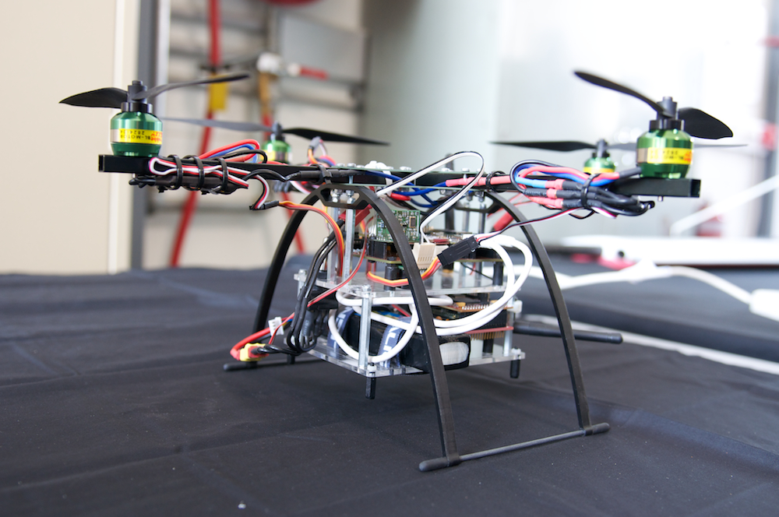
AHNS Project Aim
The Autonomous Helicopter Navigation System 2010 is focused on developing a helicopter system capable of autonomous control, navigation and localising within a GPS denied environment.

Slide 3
Contents
Overview of the Project
Airframe and Hardware
On-board Flight Computer
State Estimation
Ground Control Station
Control Architecture
Hardware Mounting System
Project Summery

Slide 4
Project Overview
Michael Hamilton- 06219314

Slide 5
High Level Objectives
Michael Hamilton- 06219314

Slide 6
High Level Objectives
A platform should be developed and maintained to facilitate flight and on board hardware integration.
Michael Hamilton- 06219314

Slide 7
High Level Objectives
The system should be capable of determining its position with the aid of image processing within an indoor environment to an appropriate time resolution.
Michael Hamilton- 06219314

Slide 8
High Level Objectives
A method of estimating the states of the helicopter system should be designed and implemented. The resolution of the estimations should facilitate their employment in the control system design.
Michael Hamilton- 06219314

Slide 9
High Level Objectives
An autopilot system should be developed to enable sustained indoor autonomous hovering flight. The control system should be designed to enable future ingress and egress manoeuvre to longitudinal and hovering flight.
Michael Hamilton- 06219314

Slide 10
High Level Objectives
A ground control station that supports appropriate command and system setting inputs and data display and logging should be developed. The design should be derived from previous AHNS developments and enable future ground station developments.
Michael Hamilton- 06219314

Slide 11
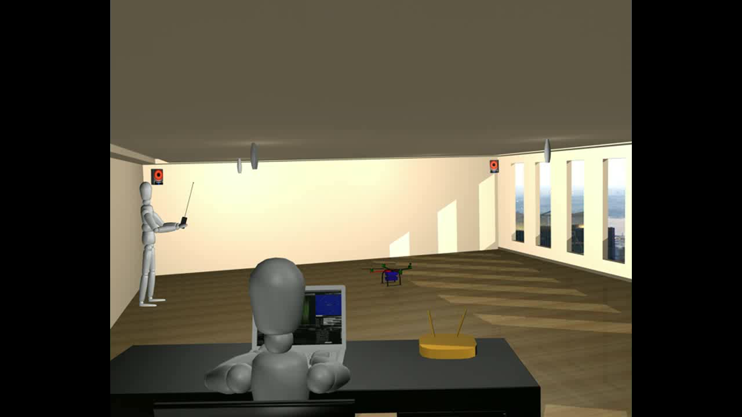
Project Virtual Demonstration

Slide 12
Systems Engineering Approach
Michael Hamilton- 06219314

Slide 13
Work Breakdown Structure
STAGE 4: Integration and
Testing
STAGE 5: Deliverables
STAGE 1: Definition and Research
STAGE 2: Design and Development
STAGE 3: Component Testing

Slide 14
Risk Management
Risk Management Plan developed mid-semester one.
After the 3rd year Quadrotor incident, all university engine testing banned indefinitely.
After approval from ARCAA H&S staff, testing continued at Airport hanger.
Michael Hamilton- 06219314

Slide 15
Platform | Pilot
Michael Kincel - 06219322

Slide 16
Platform
Airframe
Power System
Electronics
Mounting System
Michael Kincel- 06219322

Slide 17
HLO-1 Platform
SR-B-01 Manual RC Control
SR-D-01 400 Gram Payload
SR-D-02 Maintenance Document
Perform RC Test Flight
Develop Suitable Airframe
Platform
Platform
Michael Kincel- 06219322

Slide 18
Platform
Airframe
Power System
Electronics
Mounting System
Michael Kincel- 06219322

Slide 19
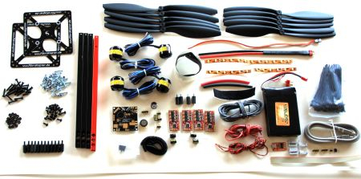
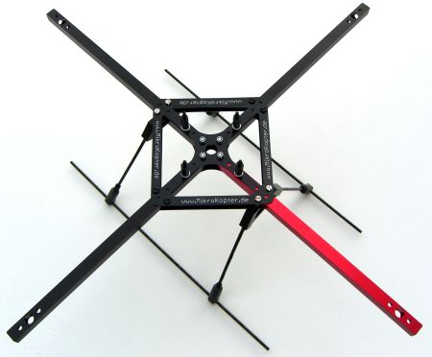
MikroKopter MK40
Readily Available
Lightweight
Durabiltiy
Fulfils Payload Requirements
Airframe

Slide 20
Platform
Airframe
Power System
Electronics
Mounting System
Michael Kincel- 06219322

Slide 21
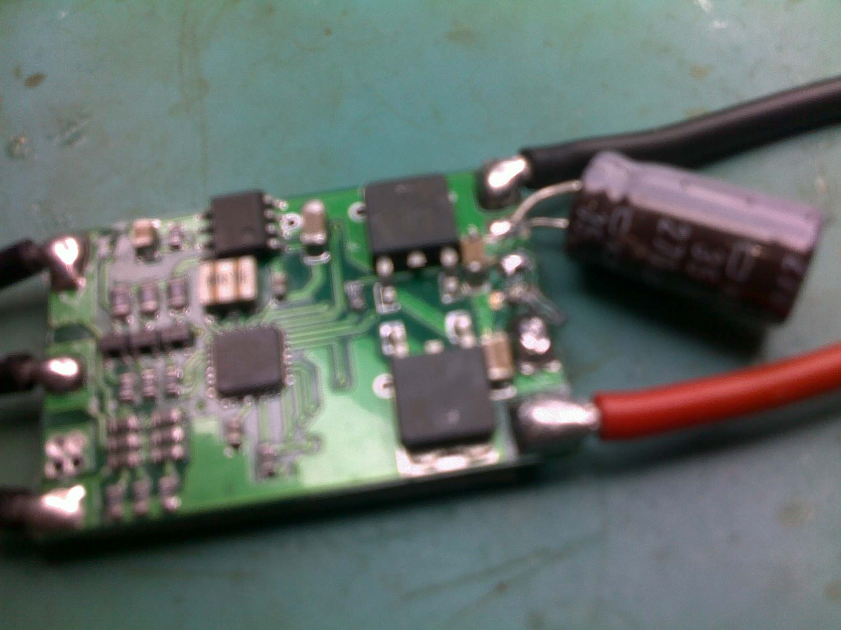
Power System
Michael Kincel- 06219322

Slide 22
Platform
Airframe
Power System
Electronics
Mounting System
Michael Kincel- 06219322

Slide 23
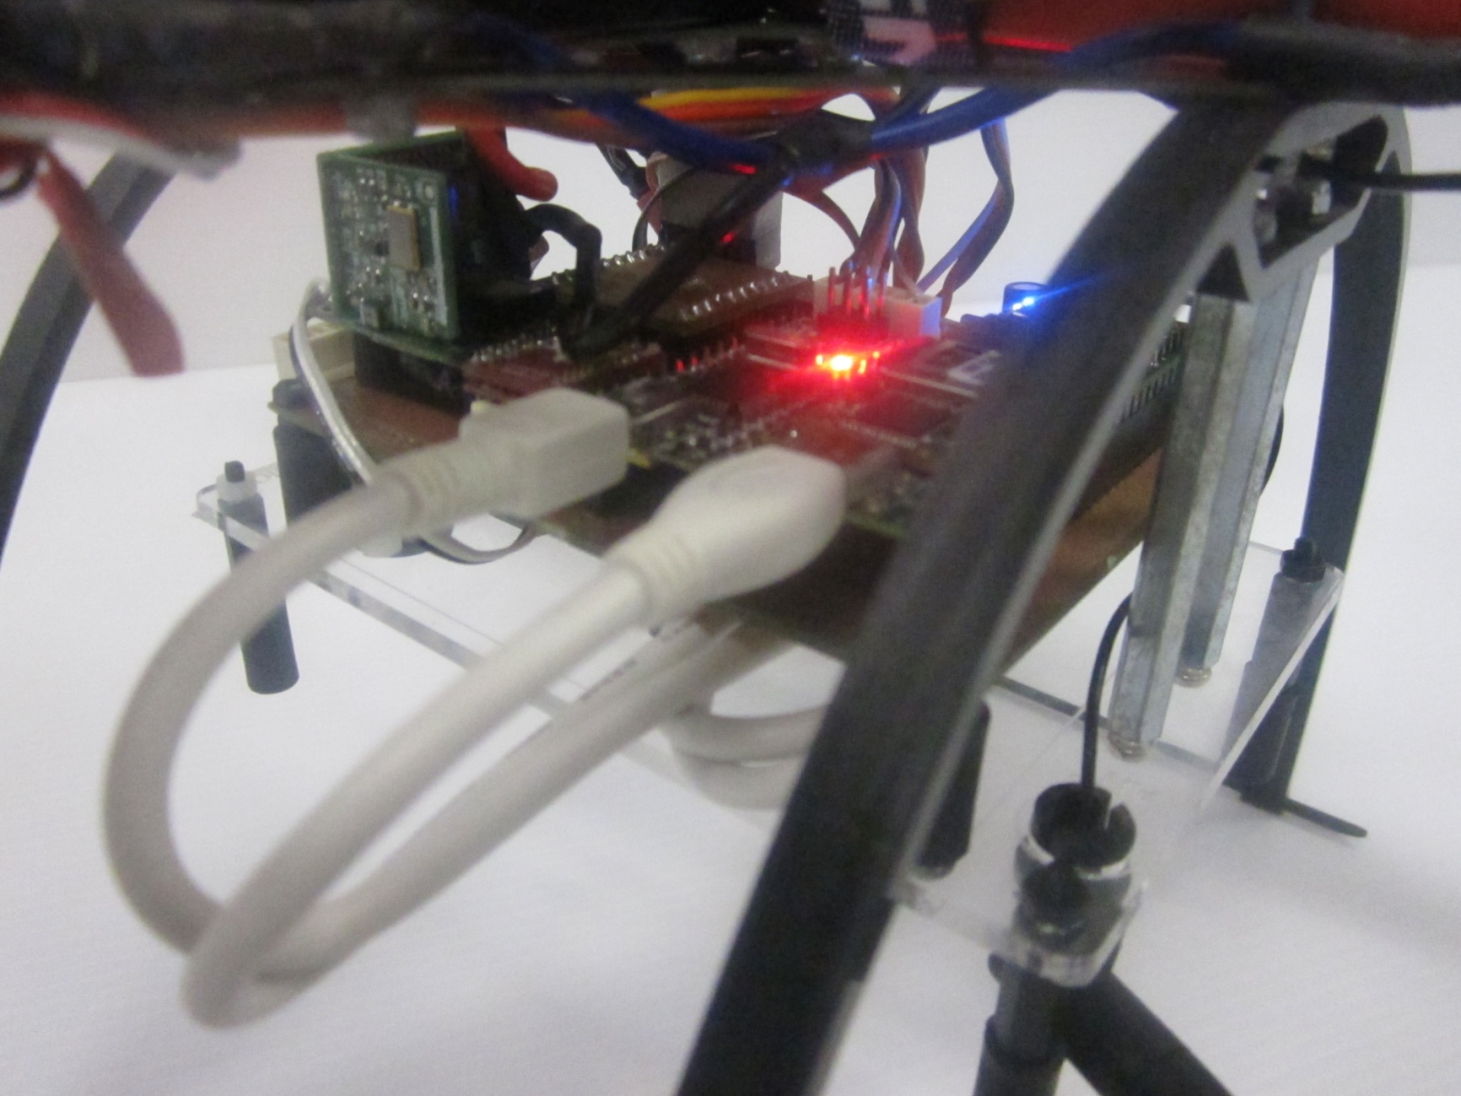
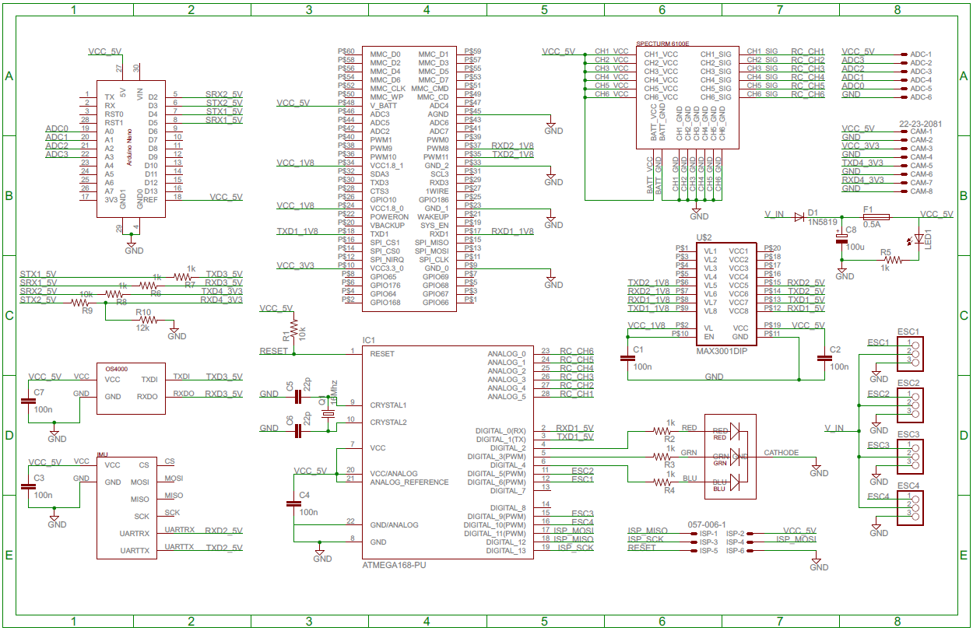
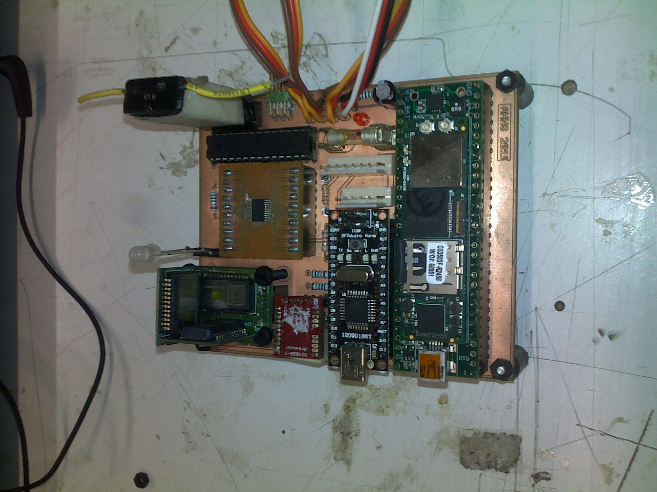
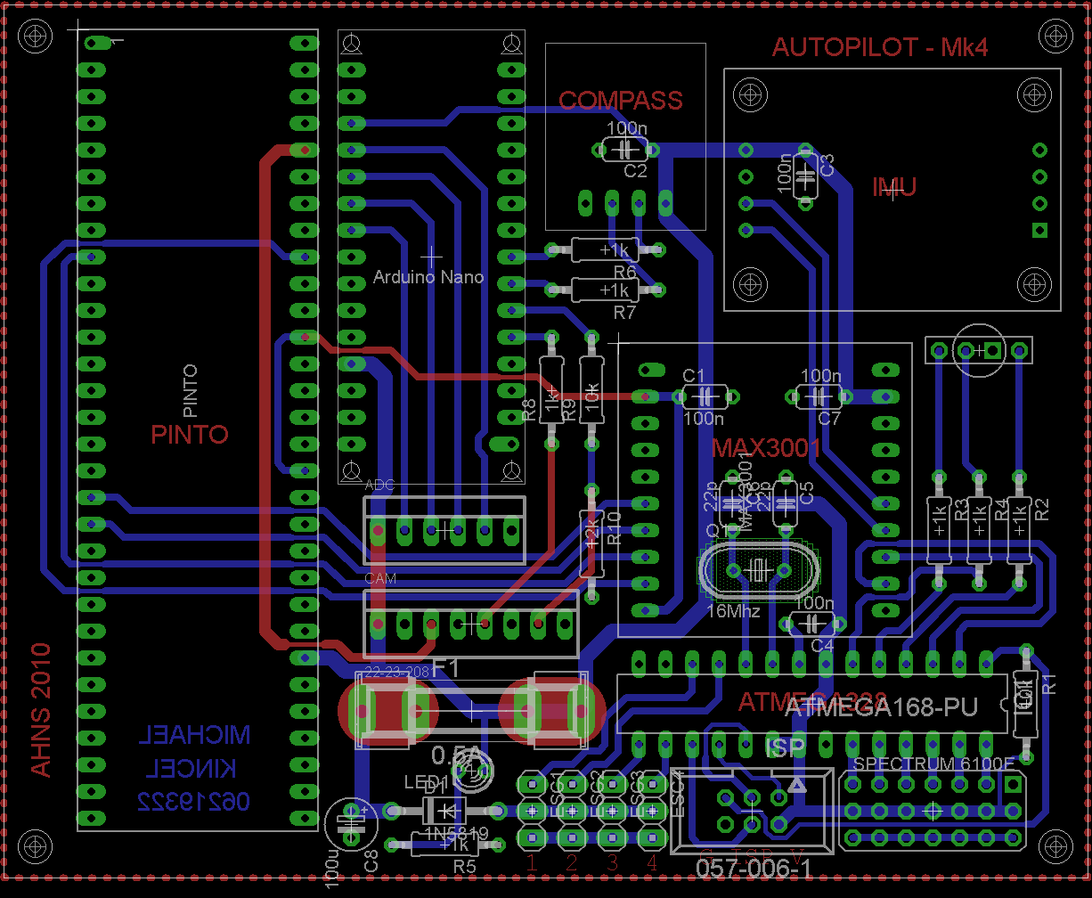
Electronics

Slide 24
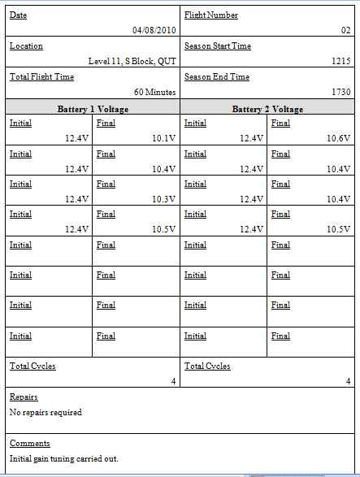
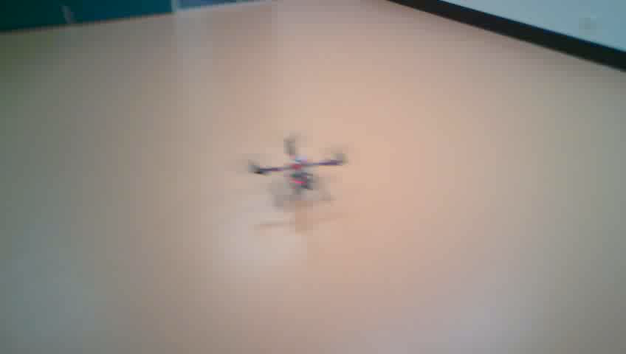
HLO-1 Platform
SR-B-01 Manual RC Control
SR-D-01 400 Gram Payload
SR-D-02 Maintenance Document
AT-01
AT-11
AT-12
Acceptance Testing
Michael Kincel- 06219322

Slide 25
Scope
Use commercial hardware if navigation is desired
Hardware Development
Minimum of two people developing hardware
Devote more time to hardware development
Dedicated project
Lessons Learnt
Michael Kincel- 06219322

Slide 26
Flight Computer (FC)
Liam O’Sullivan - 06308627

Slide 27
Flight Computer
HLO-4 Autonomous Hovering Flight
SR-D-05 and 06
Receive and process sensor data (50 Hz)
IMU Compass Ultrasonic MCU Battery voltage
Liam O’Sullivan - 06308627

Slide 28
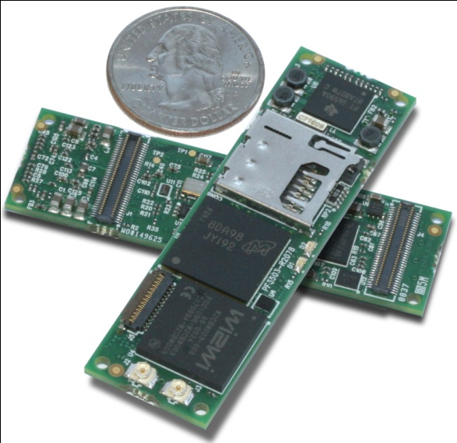
FC Design (Hardware)
Implemented on the Gumstix Overo Fire
Specification | Overo Fire
Processor | ARM Cortex-A8 OMAP3530
Clock speed | 720 MHz
Memory | 256MB RAM / 256MB Flash
Weight | 5.6g
Size | 17mm x 58mm x 4.2mm
Wireless Connectivity | Bluetooth WiFi
Features | I2C PWM (6) A/D(6) UART USB host
Overo Fire

Slide 29
FC Design (Software Architecture)
Use this text format...
FC Software Architecture
Liam O’Sullivan - 06308627

Slide 30
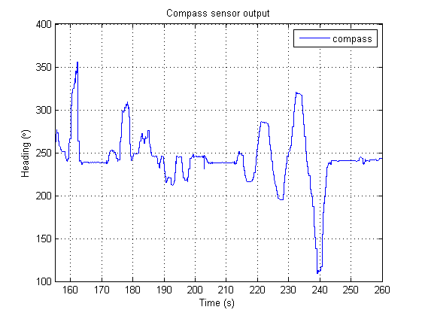
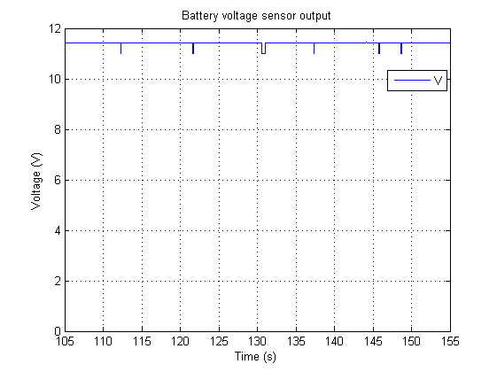
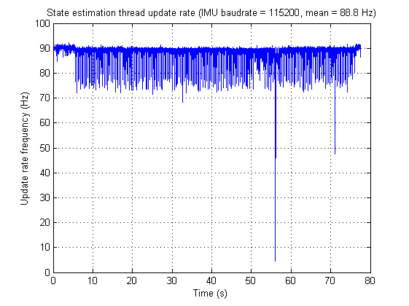
FC Acceptance Testing
HLO-4 Autonomous Hovering Flight
SR-D-05 and 06
Receive and process sensor data (50 Hz)
AT-15
AT-16
Collected compass, IMU, ultrasonic data
Processed at 50Hz
Collected battery voltage, flight status
Processed at 50Hz
Liam O’Sullivan - 06308627

Slide 31
State Estimation (SE)
Liam O’Sullivan - 06308627

Slide 32
State Estimation
HLO-3 State Estimation
SR-B-05
Altitude estimate at 50Hz
SR-B-04
Attitude estimate at 50Hz
Vicon
Ultrasonic sensor
IMU
Compass
Kalman Filtering
SR-B-06
X and Y estimate at 50Hz
Vicon
Liam O’Sullivan - 06308627

Slide 33
SE Design
15 states to be measured
State | Sensor | State | Sensor
Roll rate | X rate gyro (IMU) | Z acceleration | Z accelerometer (IMU)
Pitch rate | Y rate gyro (IMU) | X velocity | Vicon*
Yaw rate | Z rate gyro (IMU) | Y velocity | Vicon*
Roll | IMU* | Z velocity | Ultrasonic and Vicon*
Pitch | IMU* | X displacement | Vicon
Yaw | IMU* and compass | Y displacement | Vicon
X acceleration | X accelerometer (IMU) | Z displacement | Ultrasonic and Vicon
Y acceleration | Y accelerometer (IMU)
* indirect measurement
Liam O’Sullivan - 06308627

Slide 34
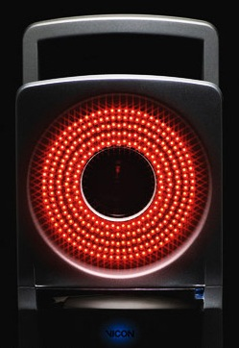
SE Design (Position and Velocity)
Vicon motion capture system
External motion capture system
Measures object translation and rotation with sub mm accuracy
200Hz update rate
Ethernet connection (via GCS)
Located at the ARCAA building
Vicon IR camera

Slide 35
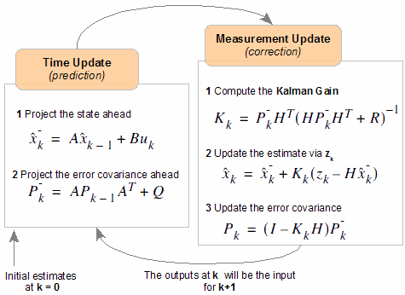
SE Design (Attitude)
Attitude estimated by 3 Kalman Filters (KF)
1 KF for each Euler angle
IMU rate data (Time Update)
IMU acc data
(Measurement Update)
Compass data
(Ψ Measurement Update)

Slide 36
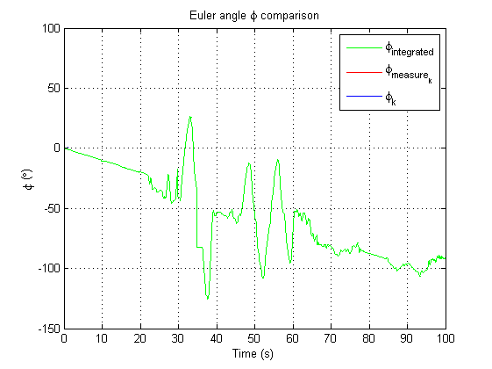
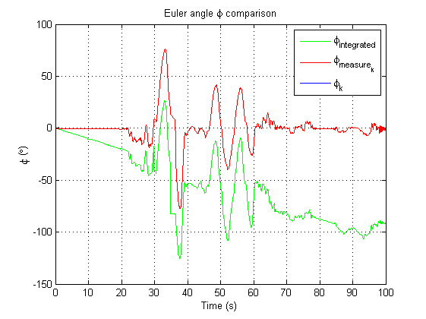
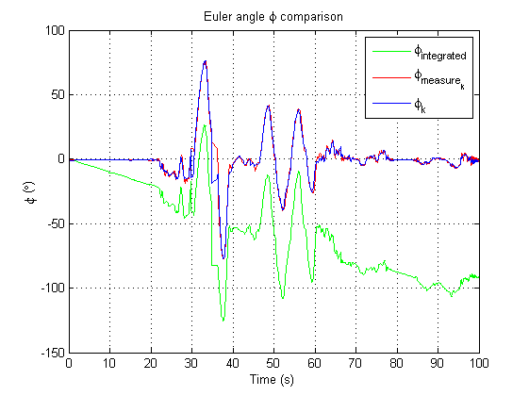
SE Design (Attitude)
Example: Estimating φ via KF
Liam O’Sullivan - 06308627

Slide 37
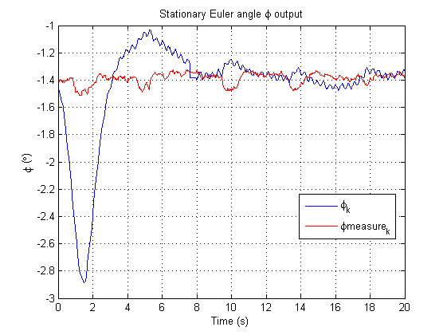
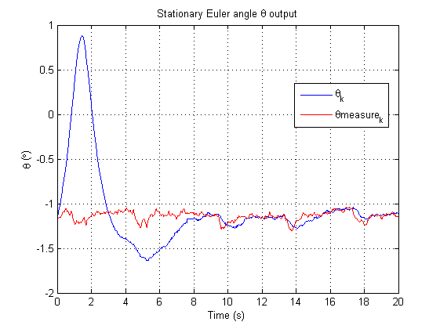
SE Testing Outcomes (Attitude)
IMU mounting error in both φ (-1.4°) and θ (-1.2°)
Liam O’Sullivan - 06308627

Slide 38
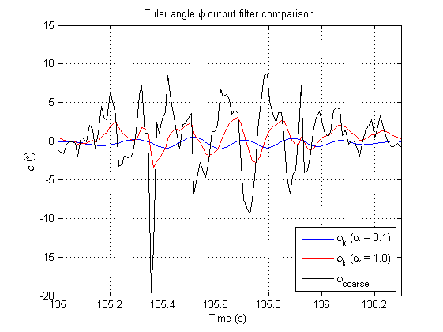
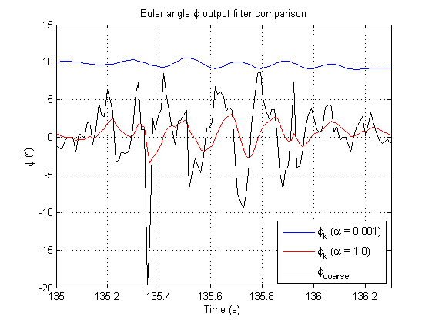
SE Testing Outcomes (Attitude)
Accelerometer low pass filtering
Liam O’Sullivan - 06308627

Slide 39
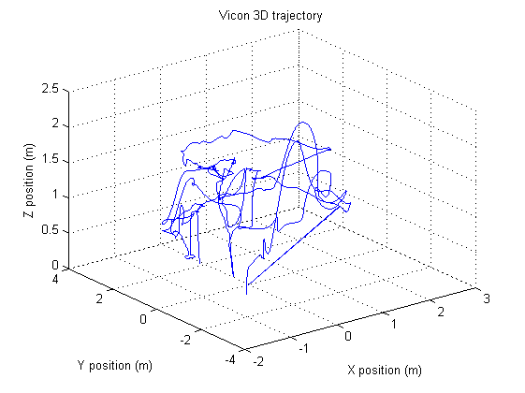
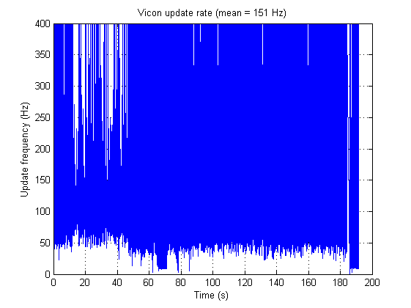
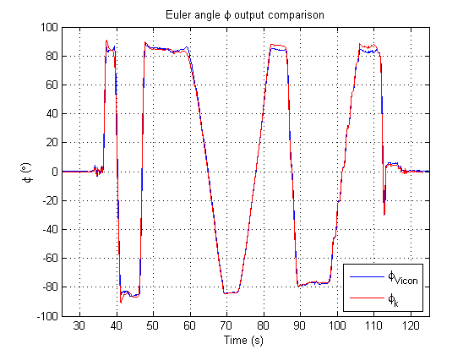
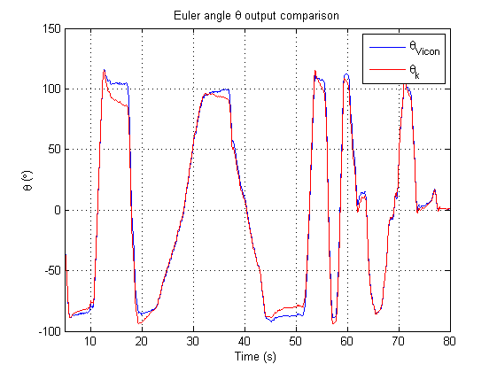
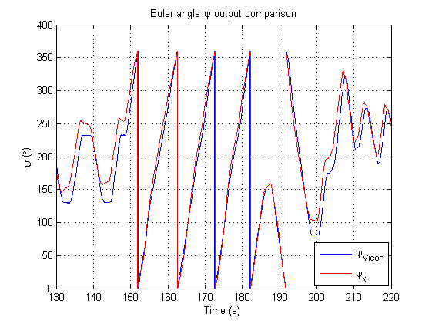
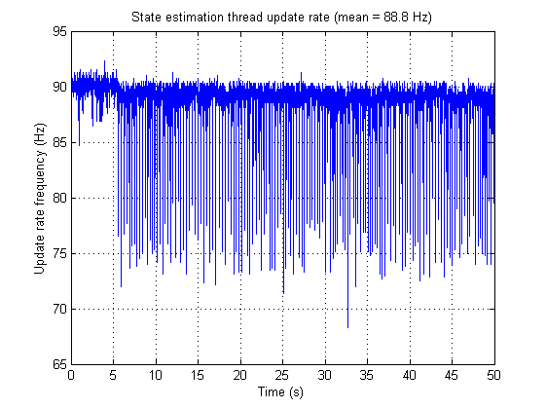
SE Acceptance Testing
HLO-3 State Estimation
SR-B-05
Altitude estimate at 50Hz
SR-B-04
Attitude estimate at 50Hz
AT-05
AT-07
SR-B-06
X and Y estimate at 50Hz
AT-06
Estimated Z position with Vicon
50Hz update
Estimated X and Y position with Vicon
50Hz update
Estimated Euler angles with IMU
50Hz update
Liam O’Sullivan - 06308627

Slide 40
Lessons Learnt
Flight computer
Too much operating system overhead
State estimation
Accelerometer data needs filtering
Ψ requires KF bound checking
Difficult to design visual control within a year (without a platform)
Liam O’Sullivan - 06308627

Slide 41
Ground Control Station Flight conTrol
Tim Molloy - 06332064

Slide 42
Ground Control Station
HLO-5 Ground Control Station
SR-B-08 and 09 Receive and Transmit Telemetry via WLAN
SR-D-07 and 08 Log Telemetry and Uplink Commands
SR-D-09 Display of State and Control Data
SR-D-10 System Status Display
Received and Transmit Consoles and Data Logger
Data Plotters & Artificial Horizon
System Status Widget
Communications and Vicon Threads; Gains and Parameter Widgets
SR-B-02 Flight Mode Switching
Flight Control Widget

Slide 43
GCS Design (Architecture)

Slide 44
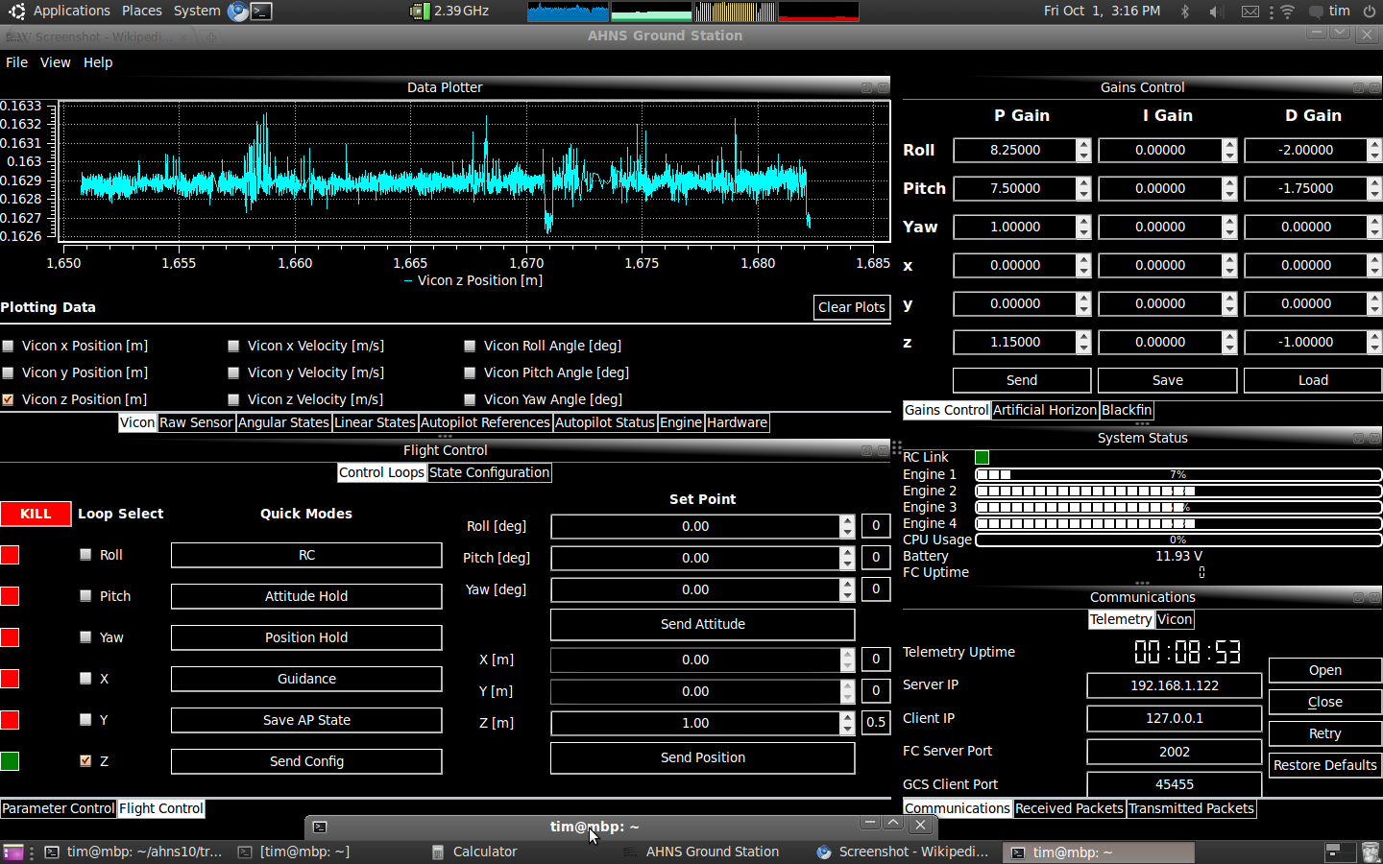
GCS Implementation (User Interface)

Slide 45
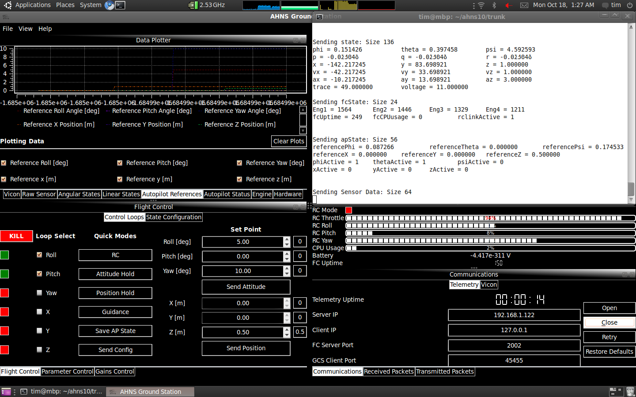
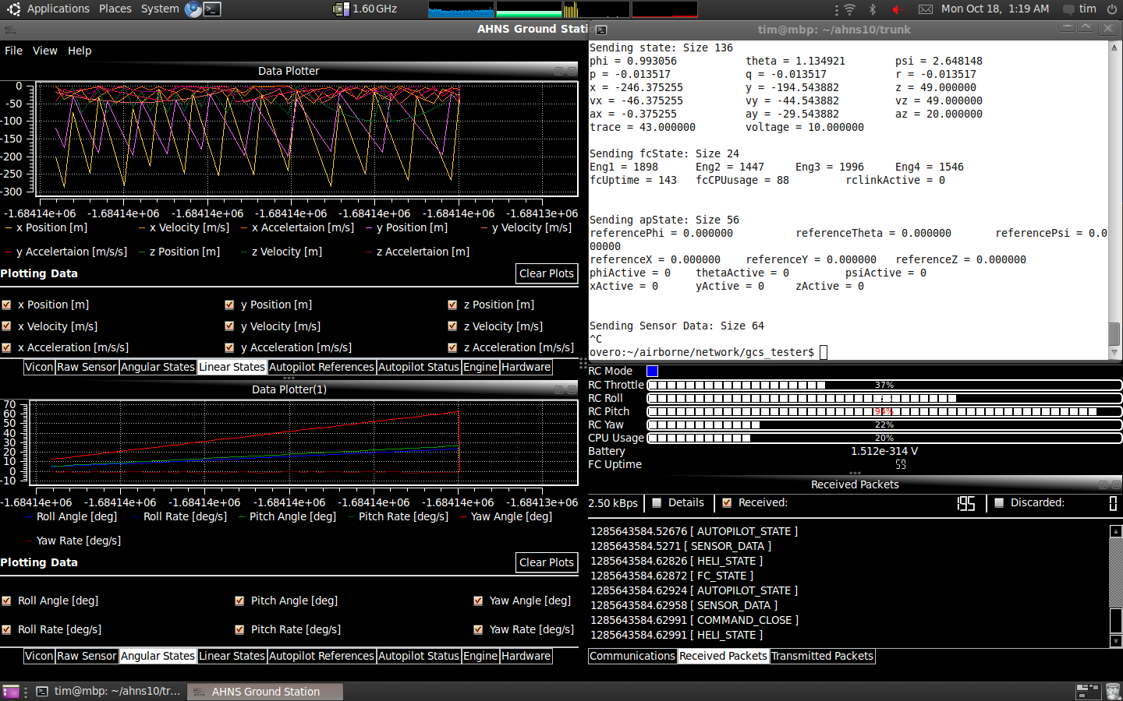
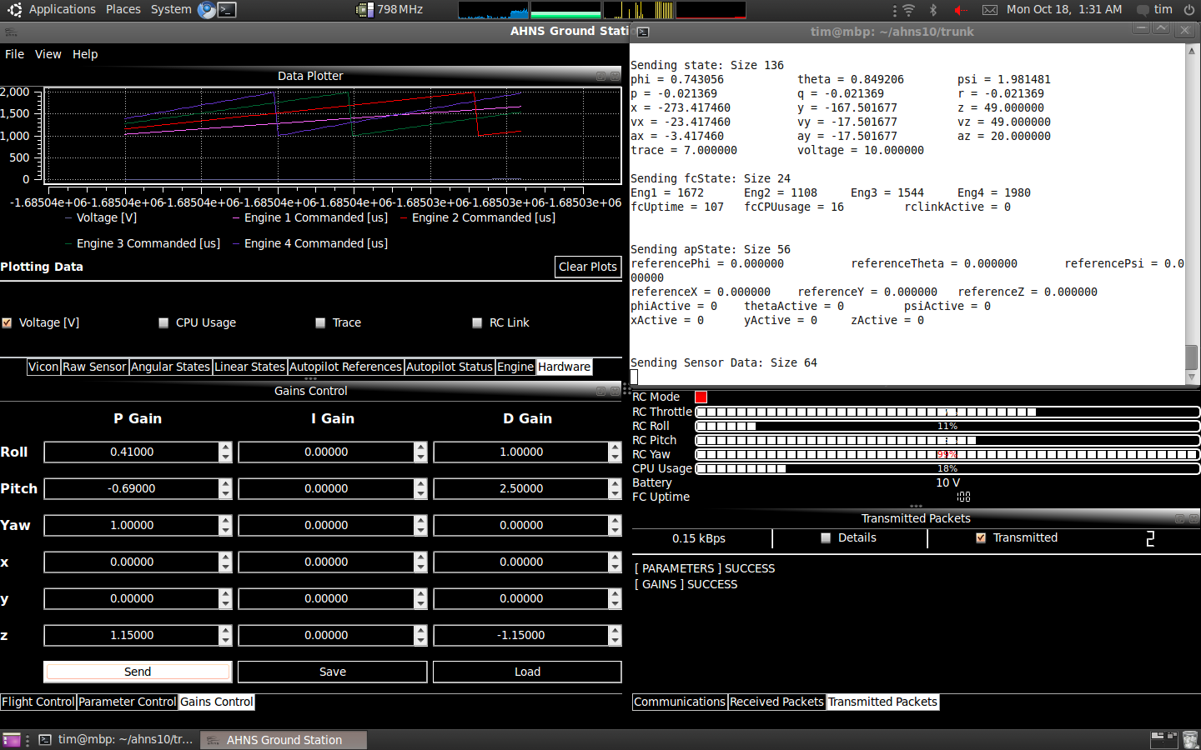
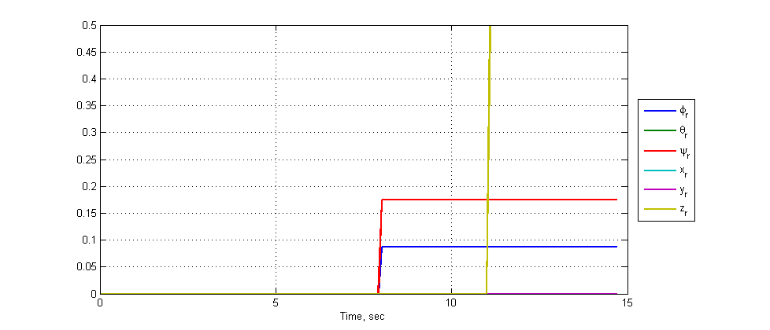
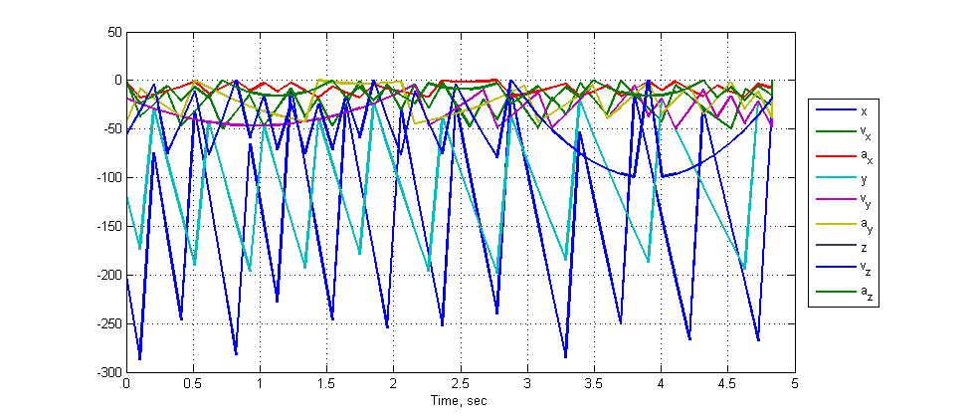
GCS Acceptance Testing
HLO-5 Ground Control Station
SR-B-09 and 08 Receive and Transmit Telemetry via WLAN
SR-D-07 and 08 Log Telemetry and Uplink Commands
SR-D-09 Display of State and Control Data
SR-D-10 System Status Display
SR-B-02 Flight Mode Switching
AT-02
AT-08
AT-17 and AT-18
AT-19
AT-20
AT-09

Slide 46
Flight Control
HLO-4 Autonomous Hovering Flight
SR-B-10 PID Control Methodology
SR-D-03 Stability Augmented Flight
SR-D-04 Autonomous Station-keeping
Control Architecture
Attitude Control
Guidance
Static Angle Setpoints
Dynamic Angle Setpoints
Dynamic Angular Rate Setpoints
SR-B-03 50Hz Control Rate
Control and Mode Control Unit Flight Computer Update Rate

Slide 47
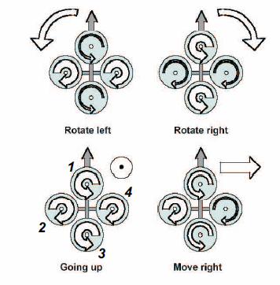
Quadrotor Control
Thrust Altitude Control Forces
Thrust Roll Control Forces
Thrust Pitch Control Forces
Drag Yaw Control Forces

Slide 48
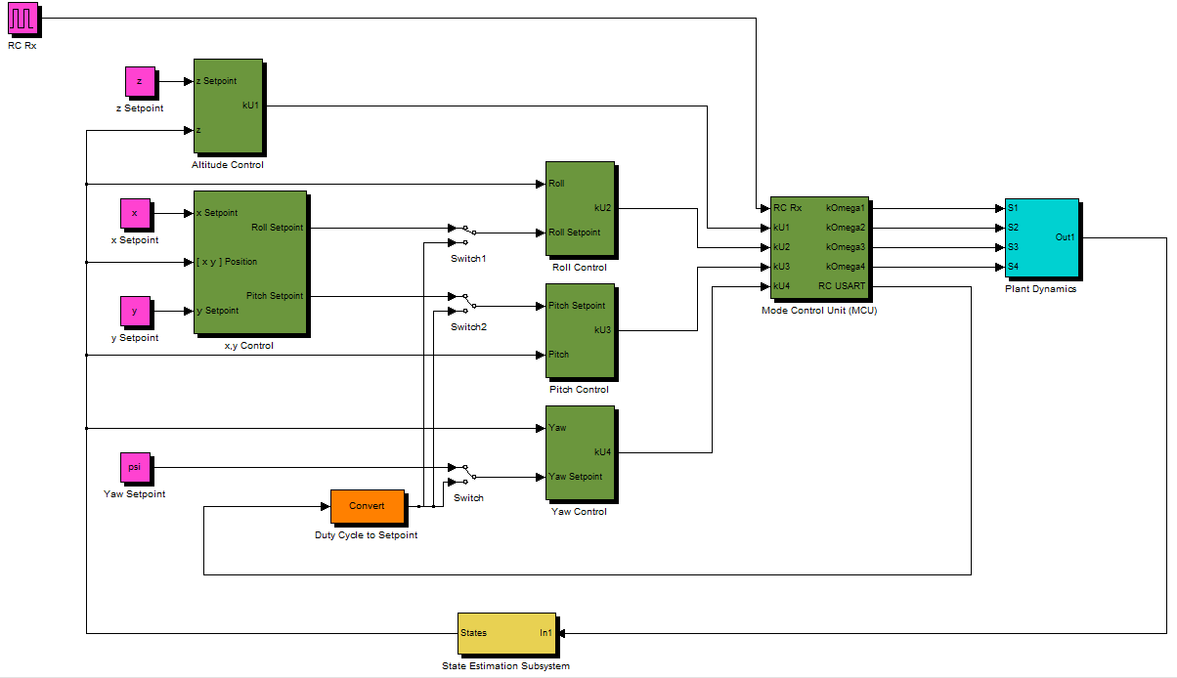
Flight Control (System Architecture)
Position Control
Attitude Control

Slide 49
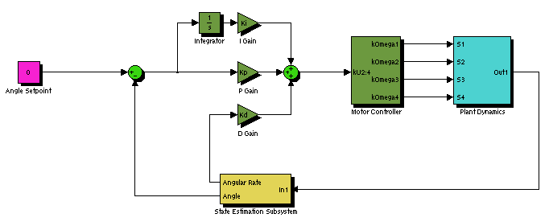
Static Angle Based Attitude Control
Developed in simulator
Implemented and Tested in Test Rig
Did not afford attitude control and removed safety pilot from loop

Slide 50
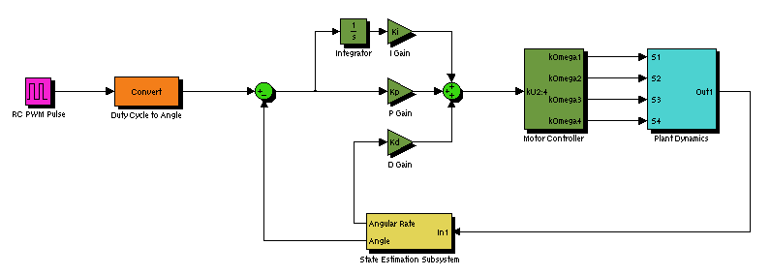
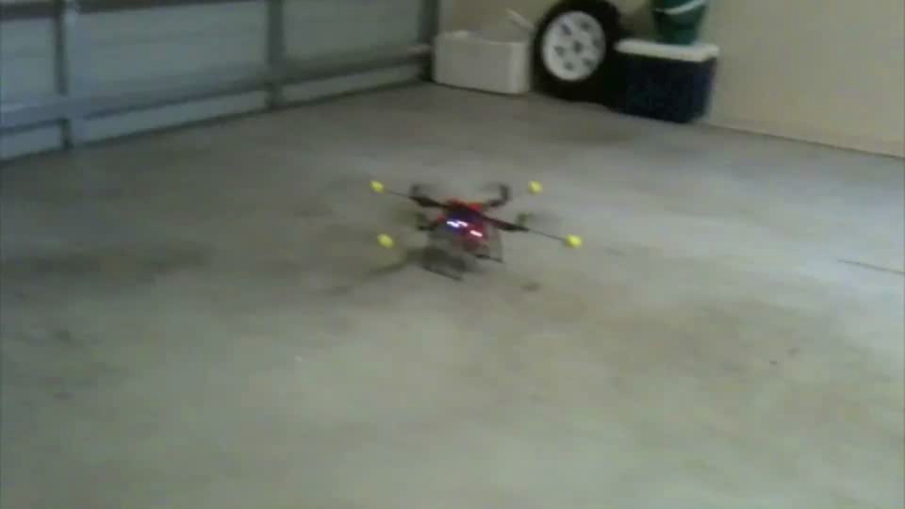
Angle Based Attitude Control

Slide 51
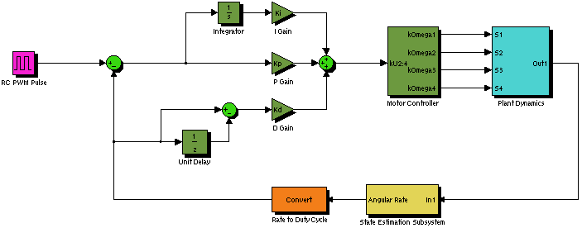
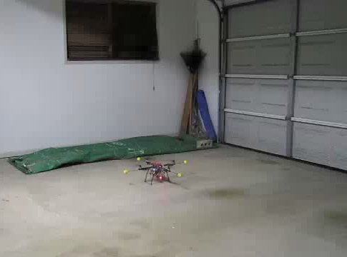
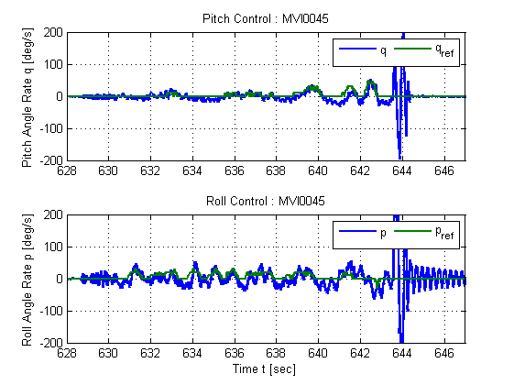
Dynamic Rate Based Attitude Control

Slide 52
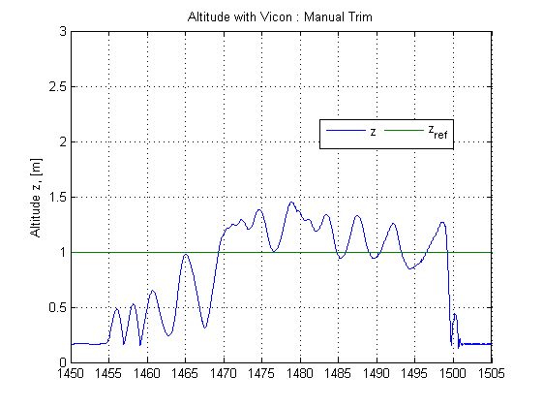
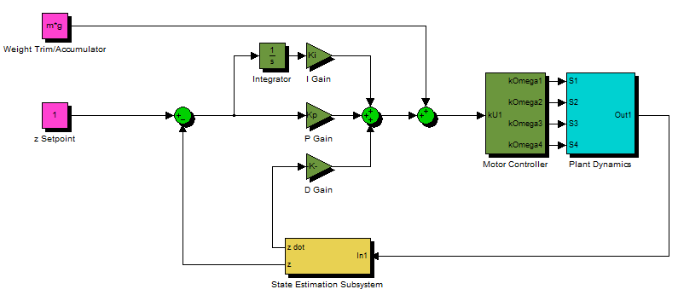
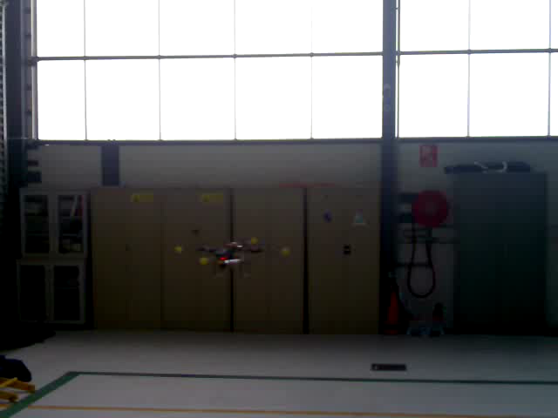
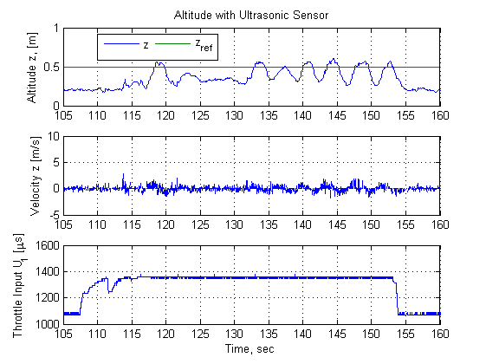
Altitude Control

Slide 53
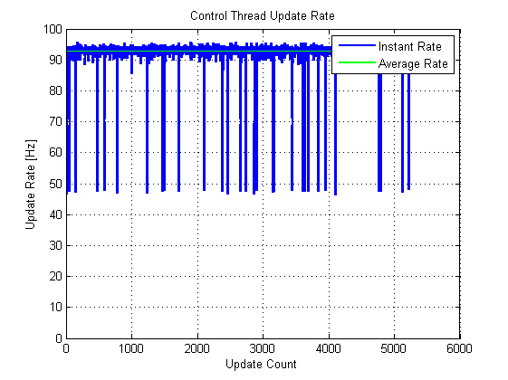
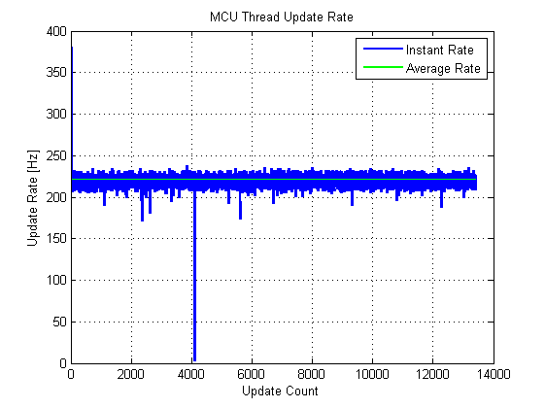
Flight Control Acceptance Testing
HLO-4 Autonomous Hovering Flight
SR-B-10 PID Control Methodology
SR-D-03 Stability Augmented Flight
SR-D-04 Autonomous Station-keeping
AT-10
AT-13
AT-14
SR-B-03 50Hz Control Rate
AT-03

Slide 54
Lessons Learnt
GCS
Emphasis on modular design, unit testing and documentation tools to maximise code reuse
Avoidance of “from scratch” development
Control
Separation of State Estimation and Controller Testing
Reliance on controller designs based on proven implementations rather than simulations
Limitations on use of testing apparatus to mitigate risks
Effects of PWM resolutions on control performance
Avoidance of USART Update Limitations in Control

Slide 55
Hardware mounting
Michael Hamilton- 06219314

Slide 56
Hardware Mounting System
The design will protect the electronic equipment from striking the ground or other parts of the airframe in the event of a crash.
The frame that supports the equipment will be made of a material that will snap under a large instant force, such as a crash, to prevent this shock damaging the main electronics board or airframe.
The mounting system will be easy and cheap to manufacture, and within a local area to reduce delivery time.
Allow easy access to electronics and line of sight to all LED’s.
Michael Hamilton- 06219314

Slide 57


Initial Design
Michael Hamilton- 06219314
Michael Hamilton- 06219314

Slide 58




Final Design
Michael Hamilton- 06219314
Michael Hamilton- 06219314

Slide 59
Project Summery
Michael Hamilton- 06219314

Slide 60
Finial Budget
Company | Items Description | Debit | Credit | Total
QUT | BEE Unit Funds | $0.00 | $400.00 | $400.00
Boeing | Boeing Sponsership | $0.00 | $2000.00 | $2400.00
HiSystems GmBH | Quad Copter Airframe | $759.86 | $0.00 | $1640.14
Surveyor Corporation | Camera | $248.75 | $0.00 | $1391.39
Gumstix inc | Onboard Computer | $395.92 | $0.00 | $995.47
HobbyRama | V-Tail Mixer | $82.00 | $0.00 | $913.47
Bunning’s Warehouse | Glue | $16.03 | $0.00 | $897.44
Eckersley | Wiring Equipment | $29.95 | $0.00 | $867.49
QUT Bookshop | Writing Material | $5.70 | $0.00 | $861.79
Jaycar Autralia | Cable | $10.67 | $0.00 | $851.12
RS Components | Coolum Counter | $37.07 | $0.00 | $814.05
Farnel | Electrical Parts | $138.33 | $0.00 | $675.72
H.E.Supplies Pty Ltd | Metal Components | $44.85 | $0.00 | $630.87
New Generation Hobbies | Motors | $221.55 | $0.00 | $409.32
HobbyKing | ESC | $100.53 | $0.00 | $308.79
 |  |  | Total Remaining | $308.79
Michael Hamilton- 06219314

Slide 61
Conformance Matrix
Number | Definition | Status | Reference Document
SR-B-01 | The platform shall have the ability to be manually manoeuvred with a radio controller. | Complete | AHNS-2010-PL-TR-002
SR-B-02 | The GCS shall enable autopilot flight mode switching between manual, stability augmented flight, and autonomous station keeping. | Complete | AHNS-2010-GC-TR-001
SR-B-03 | The airborne system shall provide control updates at an average rate of 50Hz. | Complete | AHNS-2010-AP-TR-001
SR-B-04 | The estimator shall provide Euler angle and rate estimation for the system an average rate of 50 Hz. | Complete | AHNS-2010-SE-TR-001
SR-B-05 | The estimator shall provide altitude estimation for the system an average rate of 50 Hz. | Complete | AHNS-2010-SE-TR-001
SR-B-06 | The estimator shall provide x and y estimation in an Earth fixed co-ordinate system an average rate of 50 Hz. | Complete | AHNS-2010-SE-TR-002

Slide 62
Conformance Matrix
Number | Definition | Status | Reference Document
SR-B-07 | The system shall use image processing to aid in state estimation of x and y in an Earth fixed co-ordinate system. | Not Complete | No Document
SR-B-08 | The autopilot system gain and reference parameters shall be updatable in flight using an 802.11g WLAN uplink from the GCS. | Complete | AHNS-2010-GC-TR-001
SR-B-09 | The airborne system shall transmit telemetry data including state data to the GCS using 802.11g WLAN. | Complete | AHNS-2010-AP-TR-002
SR-B-10 | The autopilot control methodology shall be based on cascaded PID control loops. | Complete | AHNS-2010-AP-DD-001
SR-D-01 | The platform shall be capable of maintaining controlled flight with a total payload of 400 grams. | Complete | AHNS-2010-PL-TR-002

Slide 63
Conformance Matrix
Number | Definition | Status | Reference Document
SR-D-02 | A maintenance document shall be used to log airframe flight time, battery cycles and aircraft repairs. | Complete | AHNS-2010-PL-TR-001
SR-D-03 | The autopilot shall provide stability augmented flight. | Complete | AHNS-2010-SY-TR-001 AHNS-2010-SY-TR-002
SR-D-04 | The autopilot shall provide autonomous station keeping capability within a 1 meter cubed volume of a desired position. | Not Complete | AHNS-2010-SY-TR-003 AHNS-2010-SY-TR-004
SR-D-05 | The airborne system shall receive and process measurement data from the state estimation and localisation sensors; supporting IMU, Camera, and Ultrasonic sensor. | Complete | AHNS-2010-AP-TR-002

Slide 64
Conformance Matrix
Number | Definition | Status | Reference Document
SR-D-06 | The airborne system shall collect avionics system health monitoring information in the form of radio control link status, flight mode status and battery level. | Complete | AHNS-2010-AP-TR-002
SR-D-07 | The airborne system shall collect avionics system health monitoring information in the form of radio control link status, flight mode status and battery level. | Complete | AHNS-2010-AP-TR-002
SR-D-08 | The GCS shall log all telemetry and uplink data communications. | Complete | AHNS-2010-GC-TR-001
SR-D-09 | The airborne system shall receive and process measurement data from the state estimation and localisation sensors; supporting IMU, Camera, and Ultrasonic sensor. | Complete | AHNS-2010-GC-TR-001

Slide 65
Conformance Matrix
Number | Definition | Status | Reference Document
SR-D-10 | The GCS shall provide display of avionics system health monitoring including telemetry, uplink, radio control link and battery level status read-outs. | Complete | AHNS-2010-GC-TR-001
Michael Hamilton- 06219314

Slide 66
Conformance Diagram
HLO 1
HLO 5
HLO 2
HLO 3
HLO 4
SR-B-01
SR-B-07
SR-B-04
SR-B-03
SR-B-02
SR-B-05
SR-B-6
SR-B-10
SR-B-08
SR-B-09
SR-D-01
SR-D-02
SR-D-03
SR-D-05
SR-D-04
SR-D-06
SR-D-07
SR-D-08
SR-D-09
SR-D-10

Slide 67
Conformance Diagram
HLO 1
HLO 5
HLO 2
HLO 3
HLO 4
SR-B-01
SR-B-07
SR-B-04
SR-B-03
SR-B-02
SR-B-05
SR-B-6
SR-B-10
SR-B-08
SR-B-09
SR-D-01
SR-D-02
SR-D-03
SR-D-05
SR-D-04
SR-D-06
SR-D-07
SR-D-08
SR-D-09
SR-D-10

Slide 68
Conformance Diagram
HLO 1
HLO 5
HLO 2
HLO 3
HLO 4
SR-B-01
SR-B-07
SR-B-04
SR-B-03
SR-B-02
SR-B-05
SR-B-6
SR-B-10
SR-B-08
SR-B-09
SR-D-01
SR-D-02
SR-D-03
SR-D-05
SR-D-04
SR-D-06
SR-D-07
SR-D-08
SR-D-09
SR-D-10

Slide 69
Project Summary
Designed and constructed a platform to facilitate flight utilising on board hardware and sensors.
Implemented State Estimation and PID control to enable autonomous flight.
Coded functional ground control station with 2.4 GHz wireless communication to platform.
Tuned gains for stable platform attitude while in flight.
Enabled future development on project to achieve position hold.
Michael Hamilton- 06219314

Slide 70
Lessons Learnt
System requirements and preliminary designs defined early.
Work breakdown structure organised into large overall tasks, as the project aims, designs and methods will change during the semester.
The testing phase of the project should commence at the beginning of semester two, as the AHNS project requires a lot of time for calibrating the system for flight conditions.
Organise the project time schedule to incorporate other subject assignment due dates, as project productivity was found to drop significantly during this time.
The risk management plan must be completed and approved well before testing commences, and ensure that all possible testing locations has been authorised.
Due to batteries requiring four times longer recharging that the flight time they produce, ensure a large number are available for flight-testing.
Purchase additional electrical hardware components to mitigate schedule delay from broken parts after flight crashes.
Michael Hamilton- 06219314

Slide 71
System DEMONSTRATION

Slide 72
QUESTIONS? Michael HAMILTON - 06219314 MICHAEL KINCEL - 06219322 Tim MOLLOY - 06332064 Liam O’Sullivan - 06308627

